Slide 1

SD CARD DATALOGGER
RAVI PRAKASH (EE24MT017)
YADU KRISHNAN (EE24MT013)
Notes:
This template can be used as a starter file for presenting training materials in a group setting.
Sections
Right-click on a slide to add sections. Sections can help to organize your slides or facilitate collaboration between multiple authors.
Notes
Use the Notes section for delivery notes or to provide additional details for the audience. View these notes in Presentation View during your presentation.
Keep in mind the font size (important for accessibility, visibility, videotaping, and online production)
Coordinated colors
Pay particular attention to the graphs, charts, and text boxes.
Consider that attendees will print in black and white or grayscale. Run a test print to make sure your colors work when printed in pure black and white and grayscale.
Graphics, tables, and graphs
Keep it simple: If possible, use consistent, non-distracting styles and colors.
Label all graphs and tables.

Slide 2
Problem Statement
Storing a string of data in a continuous data locations into the SD card, which can be used for data logging purpose.

Slide 3
Functions Implemented
Auto Initialization on Startup: The system automatically initializes and checks SD card compatibility on boot.
LED Indicators: LED indicators are used to simplify the selection of different operation modes.
SD Card Read Functionality: Added the ability to read data from the SD card for easy verification of written data.
Three Operation Modes: The system supports three modes of operation - sector read, sector erase, and sector write. Users can select the mode using push buttons.
Serial Interface: Enabled serial communication to monitor the microcontroller's operation step-by-step via a serial monitor on a PC.

Slide 4
Implemented Program Flow
Startup:
Initialize all peripherals.
Initialize the SD card and check its compatibility, while displaying debugging information on the PC serial monitor.
Enter a while loop, waiting for input from button SW1 to select the operation mode. The selected mode is indicated by an LED, and confirmation is required by pressing SW2.
1. Read Operation:
Debugging information is sent via serial communication.
The necessary commands are sent to the SD card to read a sector.
The received data is saved to an array.
After completion, the function exits, and the system returns to the main loop, waiting for the next mode selection.
2. Data Erase:
Debugging information is sent via serial communication.
This operation writes 0x00 to all data locations in the selected sector.
Commands are sent to the SD card to perform the write operation.
After successful completion, the function exits and returns to the main loop to wait for mode selection.
3. Data Write Operation:
Debugging information is sent via serial communication.
The necessary commands are sent to the SD card to write data.
The string data is written to the first location, followed by 0x00 written to the remaining locations.
After successful completion, the function exits and the system returns to the main loop, waiting for mode selection.

Slide 5
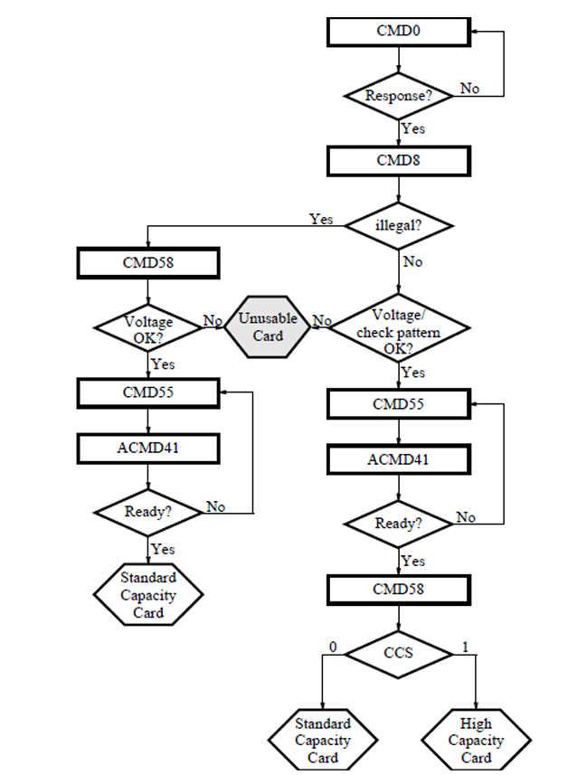
Flow Chart (Program Flow)
Set up the clock and configure the GPIO pins for SPI communication and the input button switch.
Monitor for a button press.
When a button press is detected, initialize the SD card and erase its contents.
Write a small string (e.g., "abcdefg") of data to the SD card in a continuous location (without using a file format).
Wait for the next button press, and if detected, repeat the process starting from step 3.

Slide 6
Commands Used
CMD0: Reset Command –When card supports boot functionalities and receives this command as the first one in idle state after power up, the argument is regarded as the bus mode in Fast Boot.
CMD8: Interface Condition - Sends SD Memory Card interface condition, which includes host supply voltage information and asks the card whether card supports volage.
CMD55: Application-Specific Command - Sets the context for the next ACMD.
CMD41: Card Initialization - Initializes the card and clears the idle state.
CMD58: Operating Conditions Register (OCR) - Provides card-specific details like voltage and type.
CMD16: Set Block Length - Configures the data block size.
CMD17: Read Single Block - Reads 512 bytes from a specific location.
CMD24: Write Single Block - Writes 512 bytes to a specific location.

Slide 7
CMD Index | Argument | CMD Description
CMD0 | [31:0] stuff bits or bus mode in fast boot | When card supports boot functionalities and receives this command as the first one in idle state after power up, the argument is regarded as the bus mode in Fast Boot
CMD8 | [31:12] reserved [11:8] VHS [7:0] check pattern | Sends SD Memory Card interface condition, which includes host supply voltage information and asks the card whether card supports voltage
CMD16 | [31:0] block length | In the case of a standard capacity SD memory card this command sets the block length (in bytes) for all following block commands (read, write, lock). Default block length is fixed to 512 bytes
CMD17 | [31:0] data address | In case of Standard Capacity SD Card, this command reads a block of the size selected by CMD16
CMD24 | [31:0] data address | Write a single block of data (typically 512 bytes) to the SD card at a specific address in SPI mode
CMD41 | [47:46] Start bits (01) [45:40] Command index [39:8] Argument [7:1] CRC 0 Stop bit | Used during the initialization process of an SD card in SPI mode. It prepares the card to operate and transitions it from the idle state to the ready state. This command works alongside CMD55 (Ensures card is ready for use)
CMD55 | [31:16] RCA [15:0] stuff bits | Used to indicate that the next command is application-specific (ACMD). Without CMD55, the SD card will interpret the subsequent command as a standard command instead of an ACMD (Prepares card for ACMD commands)
CMD58 | [47:46] Start bits (01) [45:40] Command index [39:8] Argument [7:1] CRC 0 Stop bit | Used to read the Operating Conditions Register (OCR) of the SD card (Checks card voltage and type)

Slide 8
Thank You

